Slide 1

Predicting customer buying behaviour

Slide 2
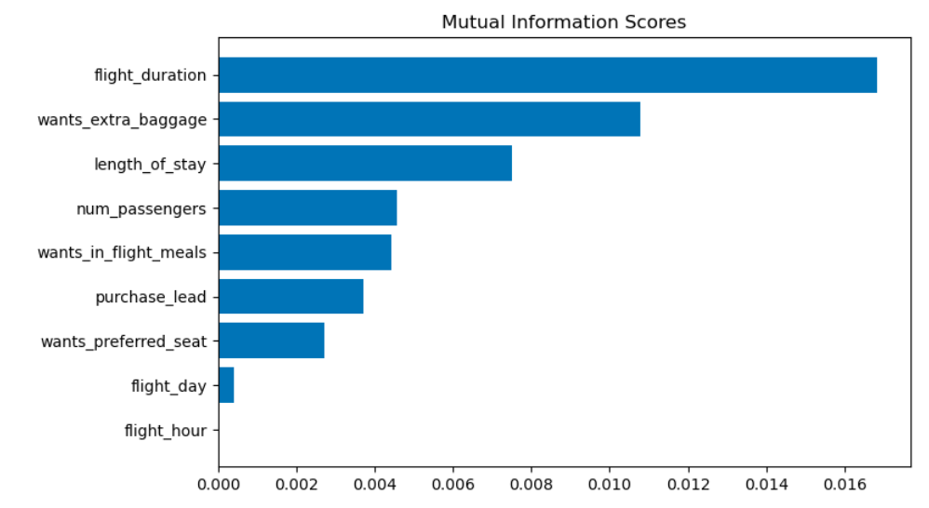
predictive model to understand factors that influence buying behavior
We have trained the data set with Random forest classifier model and received
ACCURACY: 85%
Flight Duration
Wants extra baggage
Length of stay
Number of passengers
Wants in flight meals
are the top 5 features which influence
Customer buying behavior

